Slide 1

Social Engineering Attack
EP2510 - Advanced Network System Security
Rashedul Amin Tuhin
December 14, 2012

Slide 2

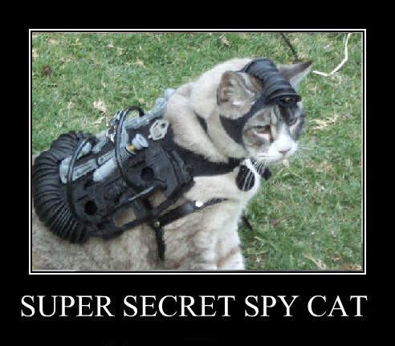
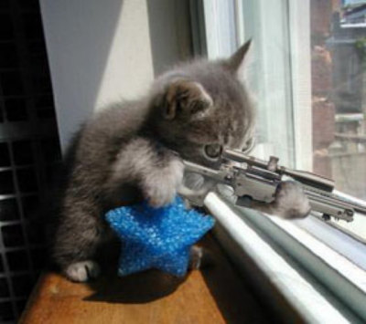
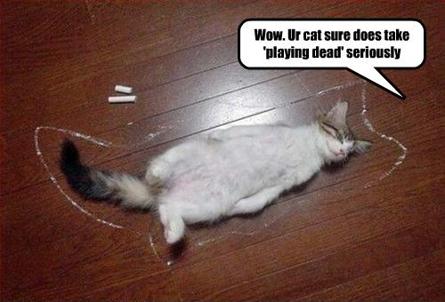
GETS HIT BY A TAXI
Notes:
A chain is as strong as its weakest link.
Acoustic Cat

Slide 3
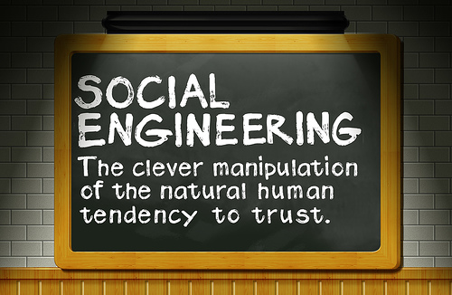
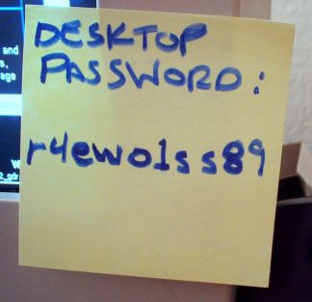

What is Social Engineering?
Manipulating the victim to do things
Victim has no idea
Provide illegitimate access to an area or privileged information
Disclosure of passwords
Notes:
Normally security threat is divided into two categories: technical hacking and social engineering.
Tricks used by the adversary to manipulate the victim to make them do things which they wouldn't normally do.
security attacks in which someone manipulates others into revealing privacy sensitive information
Social engineering is normally quite successful because most targets (or victims) want to trust people and provide as much help as possible.

Slide 4






Why should we care?
“In my mind, social engineering is the biggest issue today”
- SparkyBlaze, Anonymous.

Slide 5
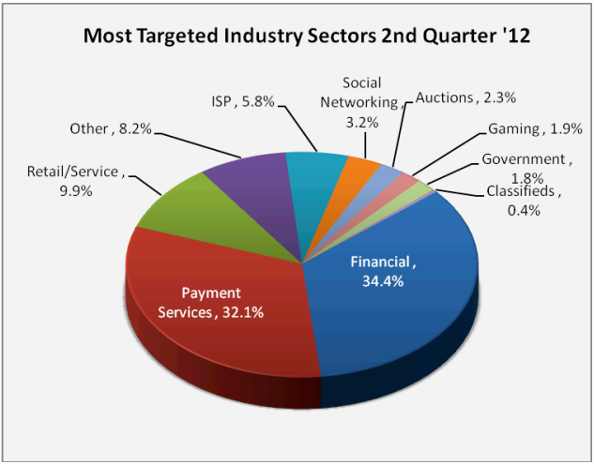
Why should we care?
Phishing Attack Trends Report - 2Q 2012 Anti-Phishing Working Group - Released September 12, 2012

Slide 6
“Successful social engineering attacks give the attacker the means to bypass millions of dollars invested in technical and nontechnical protection mechanisms and consulting, completely nullifying security investment, Firewalls, secure routers, PKI, e-mail…and security guards are all down the drain”
- Kurt Manske. (November 2000)

Slide 7
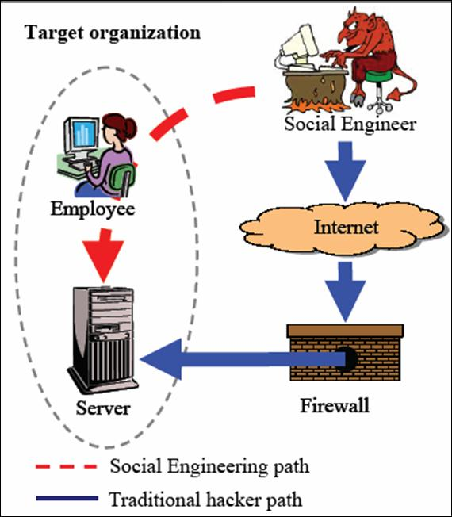
Source: Why Social Engineer (From Hermansson, 2005)
Notes:
Recall GTA San Andreas : Raiding the caligula’s casino with the help of social engineering example

Slide 8
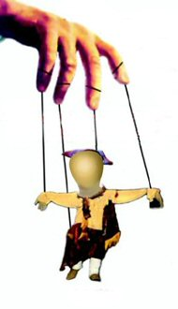
Risks Areas
Areas where persons or employees:
Have access to plenty of private/confidential information
Interact with many customers/public
Are not aware of social engineering threats
Notes:
the real and high-risk exposures are in the areas where employees:
Are not made aware of social engineering threats

Slide 9

Targets
Secretaries/executive assistants
Database administrators
Computer operators
Call center operators
Help desk attendants
General users in possession of confidential data
Notes:
Thus, typical positions vulnerable to social engineering attacks are:
Secretaries/executive assistants
Database administrators/network administrators
Computer operators
Call center operators
Help desk attendants
General users in possession of confidential data

Slide 10
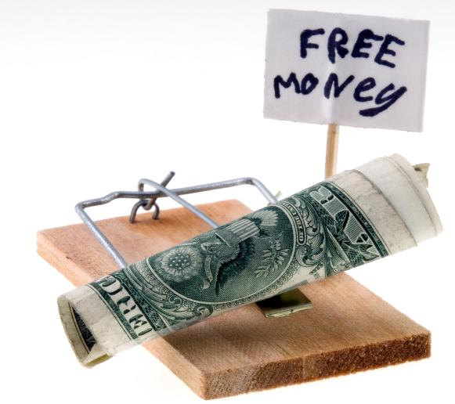
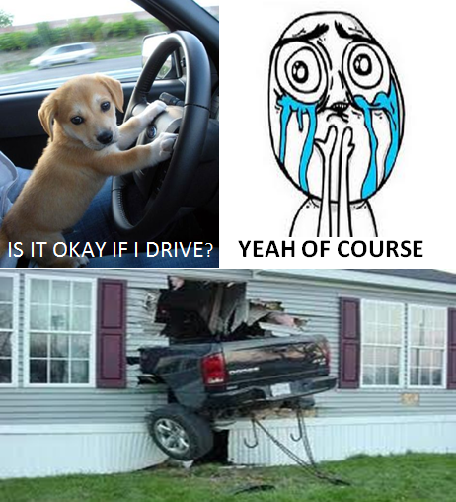

Slide 11
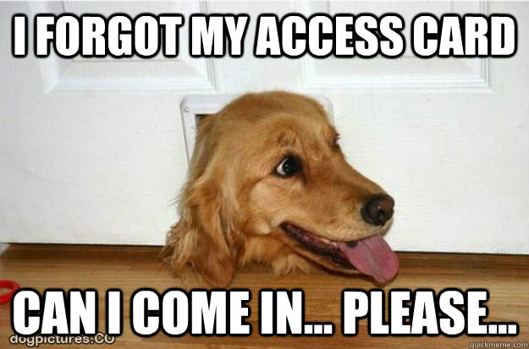
Notes:
I left my jacket at Kista campus.
The incident.

Slide 12

Yes, you can …

Slide 13
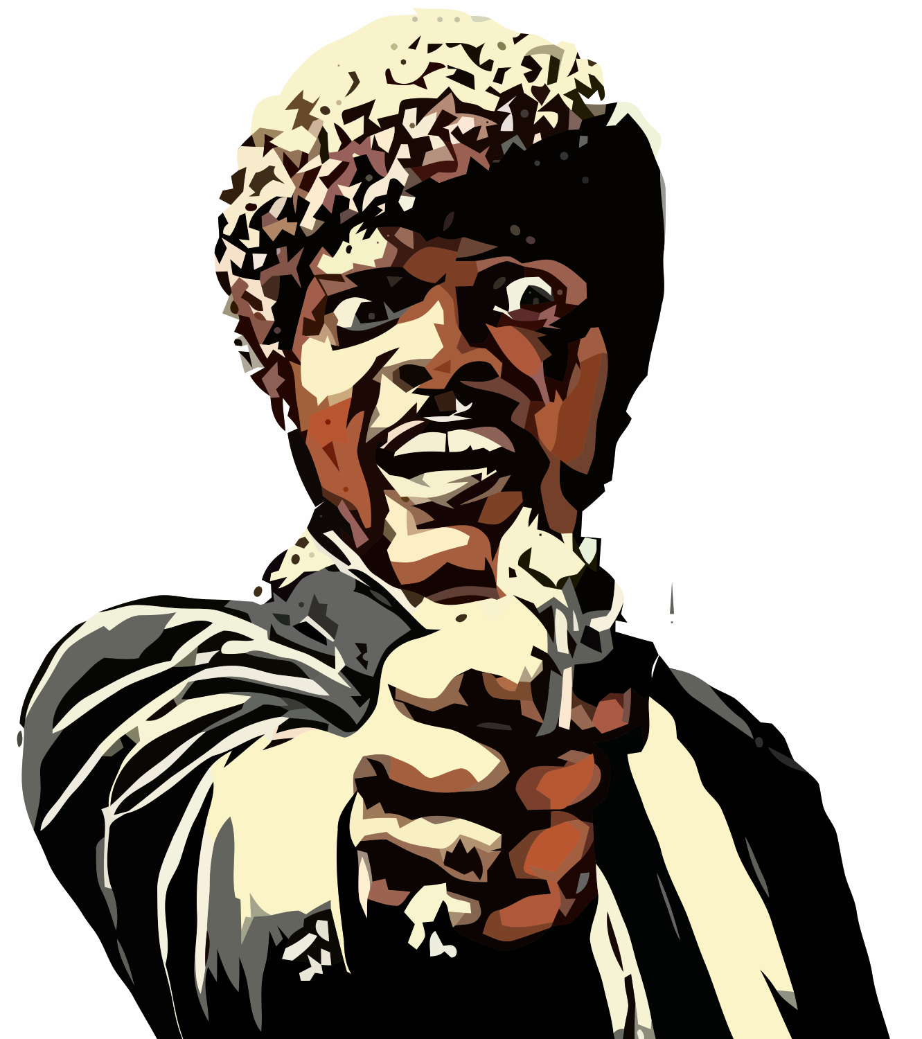
TELL ME THE PASSWORD &%#*** !!

Slide 14
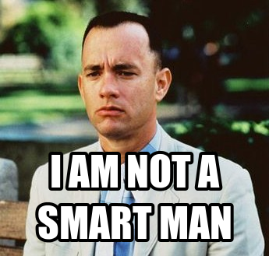

Slide 16
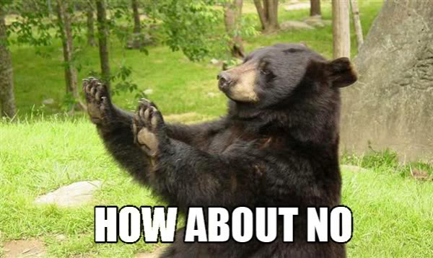

Slide 17
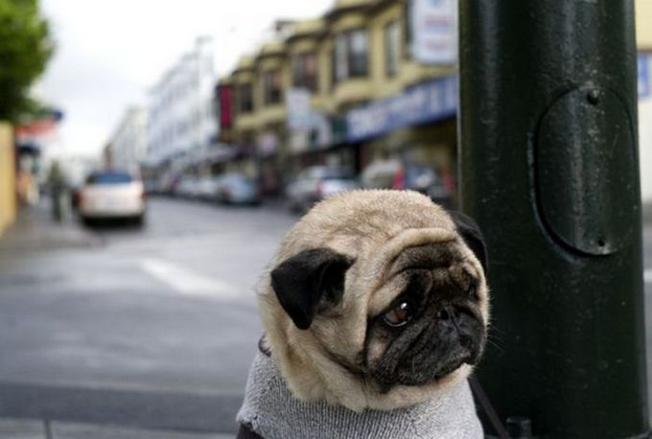

Slide 18

Exploits
Trust
Sympathy
Willingness to help
Persuasion
Decoy
Theft
Shoulder surfing
Reverse Social Engineering

Slide 19
Close-access Techniques
Posing as someone in authority
Posing as a new employee requesting help
Offering help if a problem occurs, then making the problem occur, thereby manipulating the victim to call them for help
Using insider lingo and terminology to gain trust
Notes:
Many organizations only plan for attacks directly against physical or technical resources and ignore the threat from attacks via human resources. Close-access techniques use face-to-face manipulation to gain physical access to computer systems and, ultimately, the information contained in them.

Slide 20
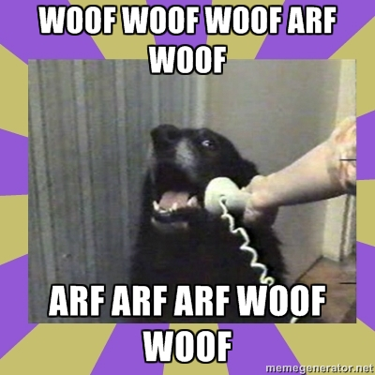
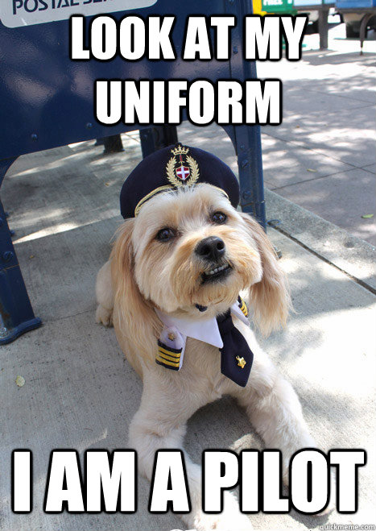
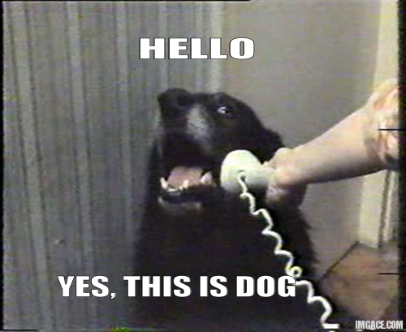
3 Steps of security
Identification
Do I know you?
Authentication
Are you who you say you are?
Authorization
Are you supposed to be here?

Slide 21
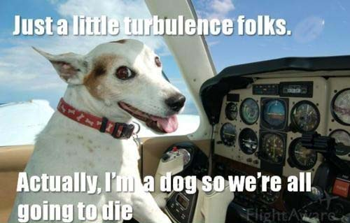

Slide 22
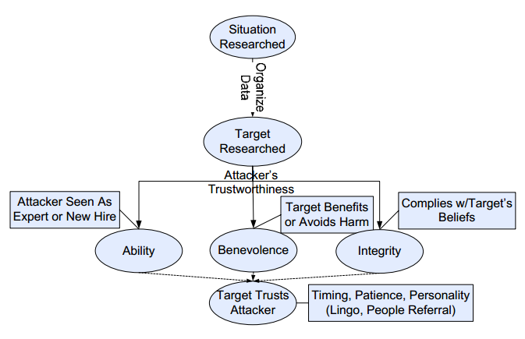
Model of Trust
Source: Laribee, L.; Barnes, D.S.; Rowe C.N.; Martell, C. H.; , “ Analysis and Defensive Tools for Social-Engineering Attacks on Computer Systems"

Slide 23
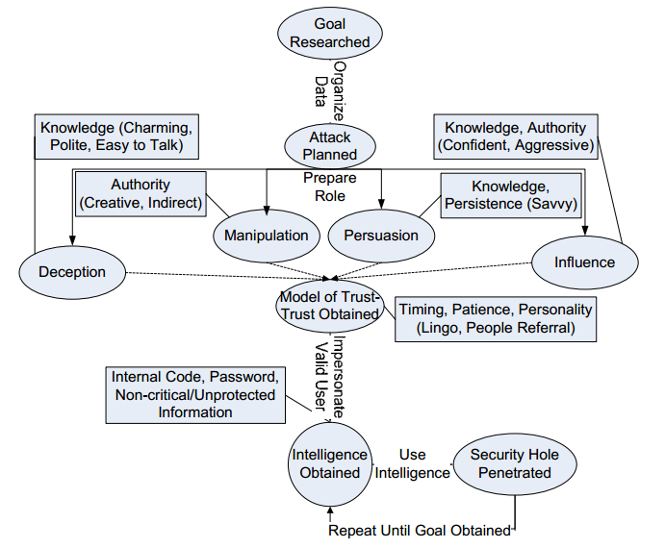
Model of Attack
Source: Laribee, L.; Barnes, D.S.; Rowe C.N.; Martell, C. H.; , “ Analysis and Defensive Tools for Social-Engineering Attacks on Computer Systems"

Slide 24


Types of attack
Human Based
Computer Based

Slide 25

Goals of the attack
Same as typical hacking
To gain unauthorized access to systems or information in order to commit crimes.
Fraud
Network intrusion
Industrial espionage
Identity theft
Disrupt the system or network

Slide 26
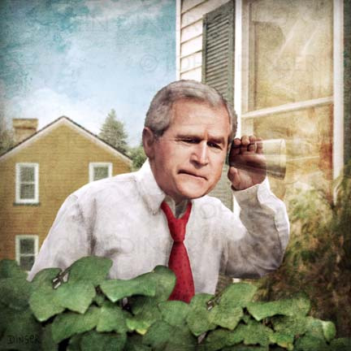
Techniques
Theft of mobile devices
Piggybacking
Tailgating
Telephonic Cheat
Eavesdropping
Notes:
Piggybacking: leaving the door open for another guy
Tailgating: Using uniform to get access to some sensitive part of the system, or getting into the server room.

Slide 27
Social Engineering by Phone
’Hi, I’m your AT&T rep, I’m stuck on a pole. I need you to punch a bunch of buttons for me.’
‘Have you been calling Egypt for the last six hours?’ ... ‘You’re responsible for the $2,000, you have to pay that...’ ‘I’m putting my job on the line … you need to read off that AT&T card number and PIN and then I’ll get rid of the charge for you.’
Similar approach is applied to obtain credit card numbers and ATM pins. Also targeted to call center employees.

Slide 28
Dumpster Diving
Company phone books
Organizational charts
Company policy manuals
System manuals
Printouts of sensitive data or login names and passwords
Printouts of source code
Disks and tapes etc.
The LAN Times listed the potential security leaks in the trash.
Notes:
Waste Disposal Example
With a t shirt and previous appointment

Slide 29

Shoulder Surfing
Video 1:
Shoulder surfing in public transport
Video 2:
Be Aware of Shoulder Surfing
Video 3:
Don’t make confidential information open to the public
(requires flash player)
Notes:
And why not eavesdropping???
https://www.youtube.com/watch?v=30Jy4JBDanI
https://www.youtube.com/watch?v=c7djxL-nfDU

Slide 30

Reverse Social Engineering
Notes:
Example: Attacker deletes a file, or moves it elsewhere, employee panics and ask for help.
Attacker says, this should be done from her account, he cant do anything for his.
Then the victim gives away sensitive information.
Don’t read below during the presenation.
************
http://www.cyberwarzone.com/content/reverse-social-engineering
A coworker hacker renames or moves a file so that the target thinks that it no longer exists. The hacker speculates that they can get the file back. The target, keen to get on with their work, or concerned that the loss of the information could be their own fault, leaps at this offer. The hacker states that this could only be done if they were to log on as the target. He or she may even say company policy prohibits this. The target will beg the hacker to log on as them and try to reinstate the file. Grudgingly, the hacker agrees, reinstates the original file, and steals the target’s user ID and password. He or she has even embellished their reputation such that they receive requests to assist other coworkers. This approach can bypass the regular IT support channels and make it easier for the hacker to remain unnoticed.

Slide 31


Slide 32

The Bohemian Scandal Attack
Notes:
Bohemian Scandal Attack: Irene Adler hides the phone, Sherlock can’t find it, stages a fire, Irene runs to save the phone first from fire thus reveals the secret location by herself.
Red Headed League attack: Targets a victim, attracts him according to his interest, and lures him to reveal information.
Blue carbuncle Attack: Makes the duck eat the gem ; used to smuggle data inside something legit.
Speckled-Band Attack: Kills in an unreachable place ; he has no access there but makes the victim do stuff for him.
Off Topic: BBC delayed the production of Sherlock until May 2013, so no new episode is coming before April 2014.

Slide 33
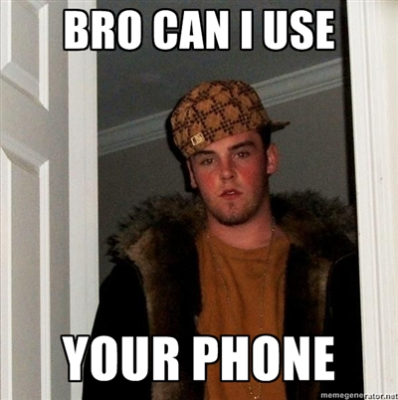
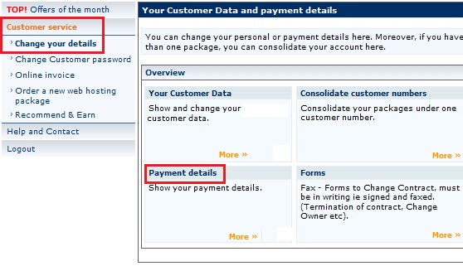
On-Line Social Engineering
Phishing
419 attack
Outdated softwares
“Update your details” ?
Impersonation
Notes:
I can call from bangladeshi number now :D bypassing the two factor authentication

Slide 34
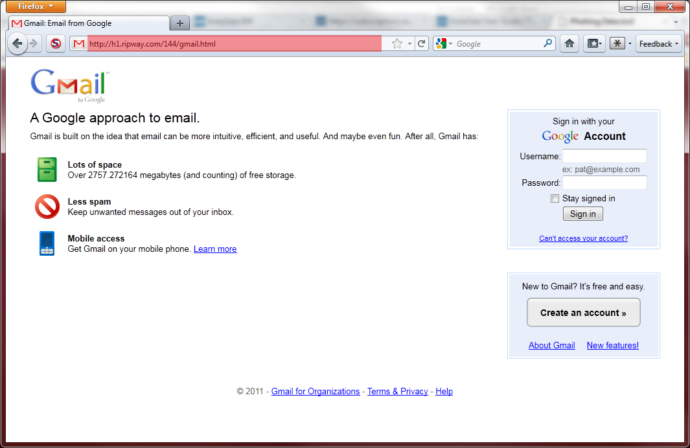
Phishing

Slide 35
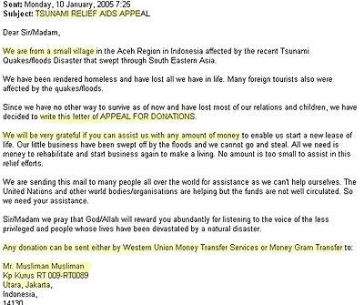
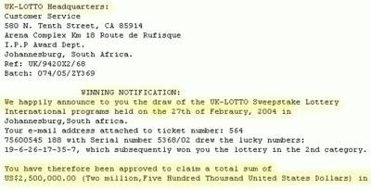
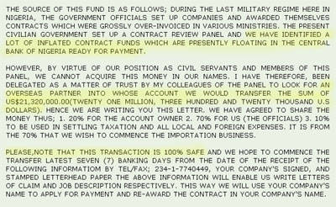

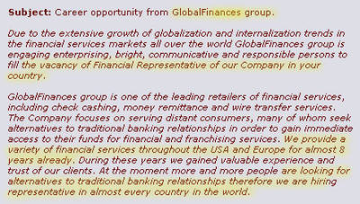
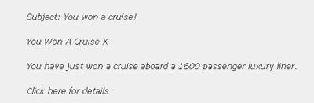
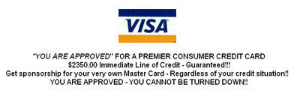
419 attacks or Scams
Notes:
Email fraud may be avoided by:
Keeping one's email address as secret as possible.
Using a spam filter.
Noticing the several spelling errors in the body of the "official looking" email.
Ignoring unsolicited emails of all types and simply deleting them.
Not giving in to greed, since greed is often the element that allows one to be "hooked".
Many frauds go unreported to authorities, due to feelings of shame, guilt, or embarrassment.

Slide 36
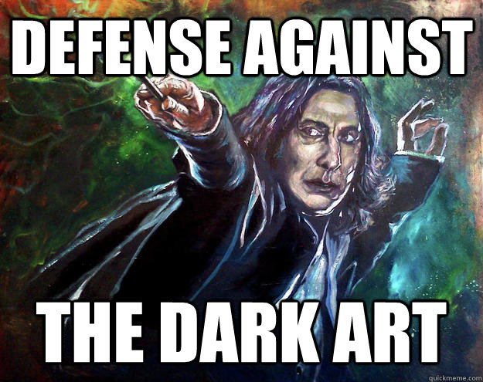
Notes:
Employee education/training
Policies and procedures
Penetration tests to gauge adherence to policies

Slide 37

Defense Against the Dark Art
Creating and Maintaining Security-Aware Culture
Employee education and training
Policies and procedures
Penetration tests
Audits
Information classification
Notes:
Employee education/training
Policies and procedures
Penetration tests to gauge adherence to policies
Creating and Maintaining a Security-Aware Culture

Slide 38
Defense Against the Dark Art
Spotting an attack
Training and retraining
Strict security policy
Preventing physical access
Phone and PABX
Incident response
Auditing
Updated softwares
Multiple security level
Realistic prevention
Penetration test
Notes:
security policies : fired guy deleted 13 GB of sensitive data
preventing physical access : Hi I am bob from your ac company, with a clipboard and a t-shirt
phone
training and retraining
spotting an attack
responding to an attack : incident response team
realistic prevention

Slide 39
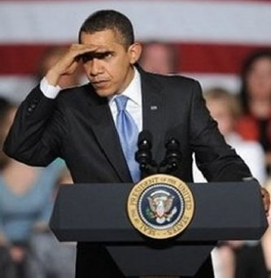
Recognizing Attack
Refusal to give a callback number
Out-of-ordinary request
Claim of authority
Stresses urgency
Threatens negative consequences of noncompliance
Show discomfort when questioned
Name dropping
Notes:
Know how its being used,
what attacks are being used,
how they are being implemented
what are the tools

Slide 40
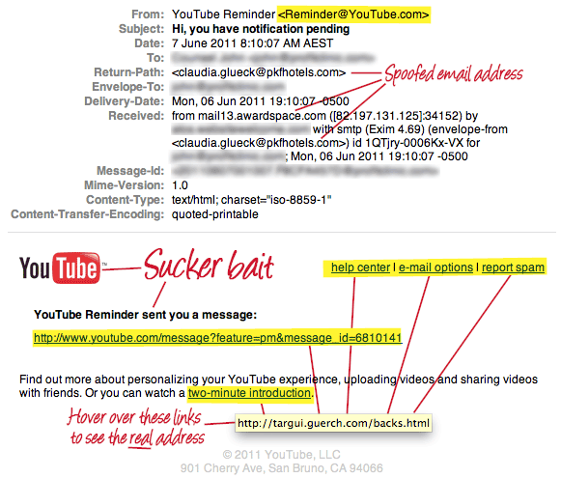

Slide 41
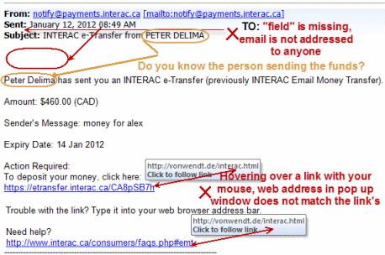

Slide 42
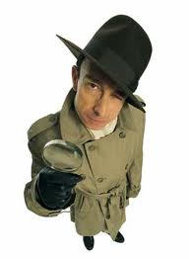

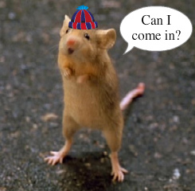
Auditing and Penetration Test
Notes:
Don’t be too confident.
May be your employees are not susceptible to phishing, our guys can handle this, but on the phone, they really provide too much information.
Auditing and penetration test helps to find out this little pieces of information that can help to work backwards.
Audit report needs to be concise and precise.

Slide 43

Security Awareness
Notes:
Training and retraining
It should become something personal
Employees need to understand the value of the what they have: for example dumpster diving

Slide 44
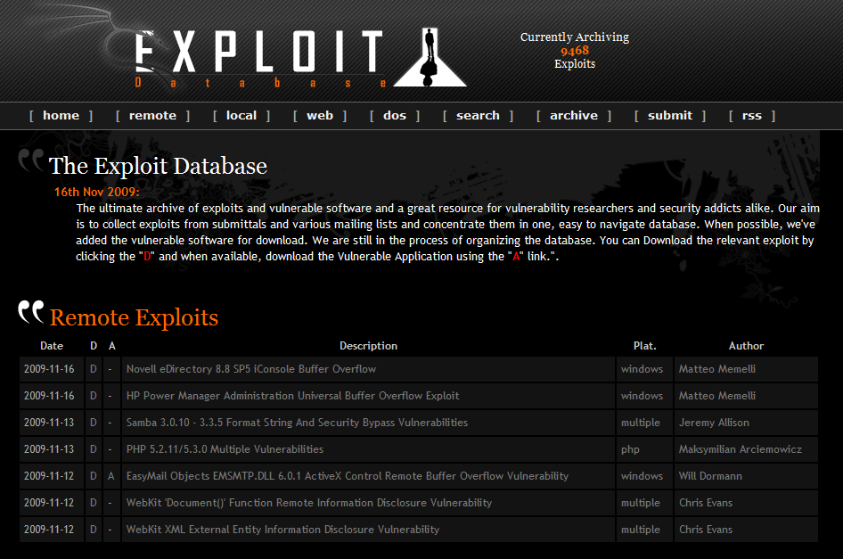
Use Updated Softwares
Published or unpublished exploits

Slide 45

Prevent Physical Access

Slide 46
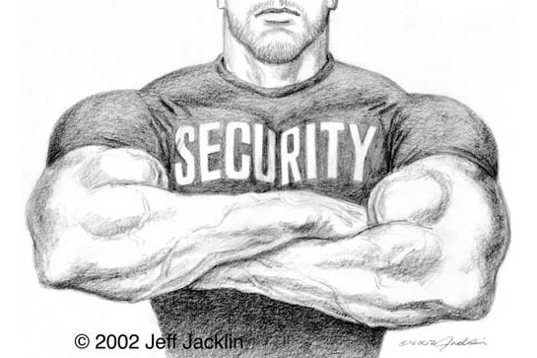
Have a Strict Policy and Stick to it
Notes:
How to fire an employee

Slide 47

Having a Clear Action Plan
Notes:
Predetermined actions upon detection
If you don’t know right now what to do when you are being social engineered, you don’t have a scripts.

Slide 48
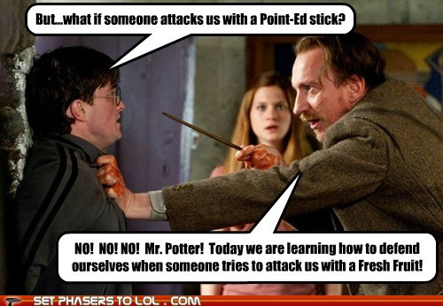
Prepare for Unusual Events
Notes:
Don’t rely too much on your actions. Don’t be too confident.

Slide 49


Slide 50

* No animals were harmed in making of this presentation.

Slide 51

Don’t be a billy.
https://youtu.be/nPR131wMKEo
Notes:
Don’t be a billy.
https://www.youtube.com/watch?v=nPR131wMKEo

